Slide 1

Bluetooth Android Intern Project Gate 2
Blaine Tiernan

Slide 2
Bluetooth Android Intern Project Gate 2
Gate 2 Deliverables/Milestones:
Risk Analysis Update
Final Schedule / Gantt
Technical Requirements Document
Detailed product requirements based on Marketing Requirements Specification (MRS)
High level software architectural solution
Traceability back to MRS
Product Development Plan
Development strategy
Resource requirements
Detailed schedule
Development costs
Project risks & mitigation

Slide 3
Financial Analysis
Risk Summary
Risk Description | Schedule Impact | Scope Impact | Budget Impact | Total Impact | Likelihood Mutliplier | Quantitative Risk Value (1-15) | Status | Mitigation
Device Remember' Function Non-Functional | 3 | 3 | 3 | 9 | 70.00% | 6.3 | Closed | Closed 9/26/13 – Function Fixed
Inexperience w/ Objective C and its Translation from Java | 3 | 3 | 3 | 9 | 100.00% | 9 | Closed | Closed 9/26/13 – Accepted as Stretch scope and will be undertaken only if time permits
G4 Device Unexpectedly Switching from Local to Remote | 4 | 5 | 4 | 13 | 80.00% | 10.4 | In Progress | Scheduled Research – attempt to never disconnect
Write Register Incompatibility with Past Design | 3 | 4 | 3 | 10 | 100.00% | 10 | Open | Suggestion: Ground up Software Rewrite
Bluetooth Successful Connection Inconsistency | 3 | 4 | 3 | 10 | 100.00% | 10 | Open | Suggestion: Ground up Software Rewrite
Register Display Facelift Requires Surplus Manhours | 2 | 3 | 2 | 7 | 80.00% | 5.6 | Open | Suggestion: Ground up Software Rewrite
Android Firmware Incompatibility | 1 | 1 | 1 | 3 | 30.00% | 0.9 | Open | Testing Application for the Most Popular Firmware Releases: 2.3.3 and 4.3

Slide 4
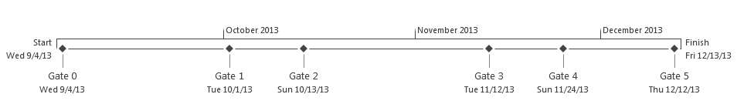
Bluetooth Android Intern Project Timeline
Today

Slide 5
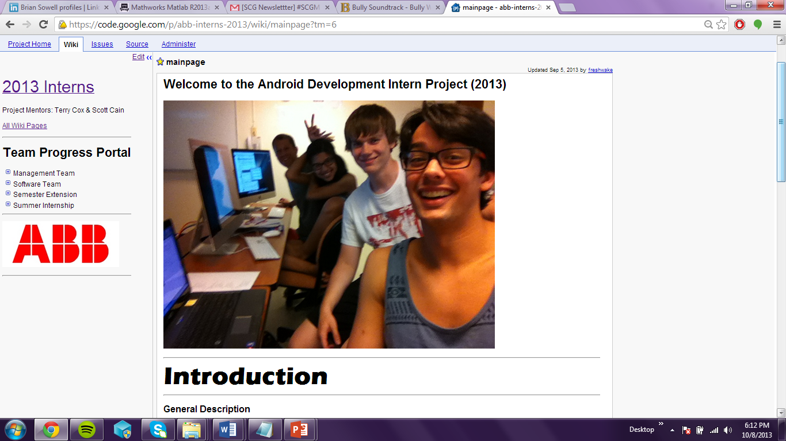
Bluetooth Android Intern Project Project Wiki (code.google.com)

